Slide 1

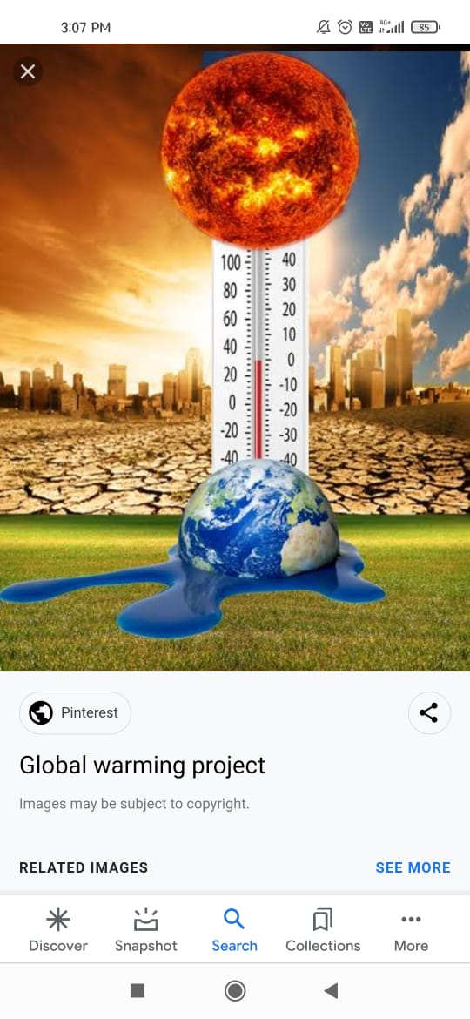
UNEARTHING THE ENVIRONMENTAL IMPACT OF HUMAN ACTIVITY: A GLOBAL CO2 EMISSION ANALYSIS

Slide 2
NAAN MUDHALVAN SCHEME
On March 1st , 2022, the Honourable Chief Minister of Tamil Nadu, launched the ambitious Naan Mudhalvan Scheme.
Helps students identify suitable career paths, access knowledge- based training to develop relevant skills, and avail career opportunities.
It create constant opportunities for the youth of Tamil Nadu to be able to acquire skills of choice.

Slide 3
TEAM MEMBERS
Dilli M
Dhanya S
Logeshwari S
Seema Begam K

Slide 4
OVERVIEW OF CO2
Accumulation of greenhouse gases in the atmosphere- from the burning of fossil fuels and deforestation-lead to a heating of the earth’s surface.
The electricity and heat sector are the main causes of co2 .
India ranks 8th in co2 emission in the world.
Co2 emissions in India rebounded strongly in 2021 to rise 80Mt above 2019 levels.

Slide 5

PURPOSE OF THE CO2
Carbon dioxide
Chemical and biological transformation
Manufacturing of synthetic fuels
Manufacturing of chemicals and material
Direct use
Food and carbonated drinks

Slide 6

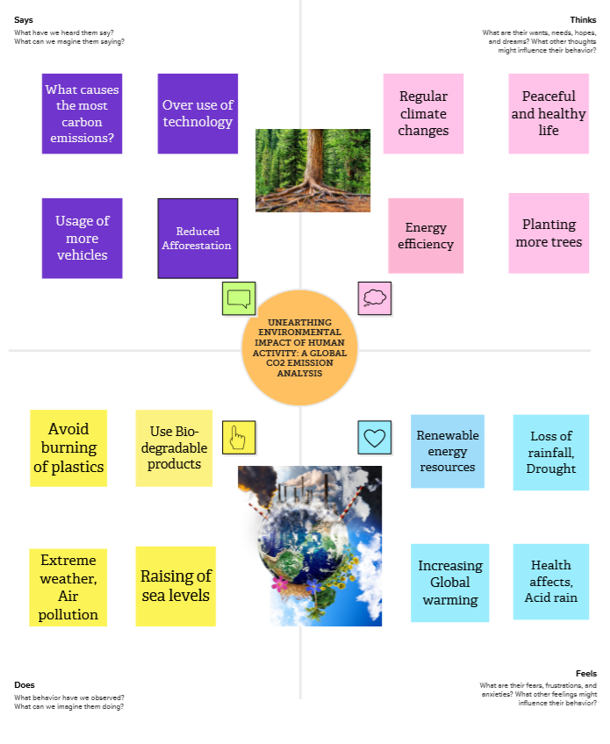
EMPATHY MAP

Slide 7

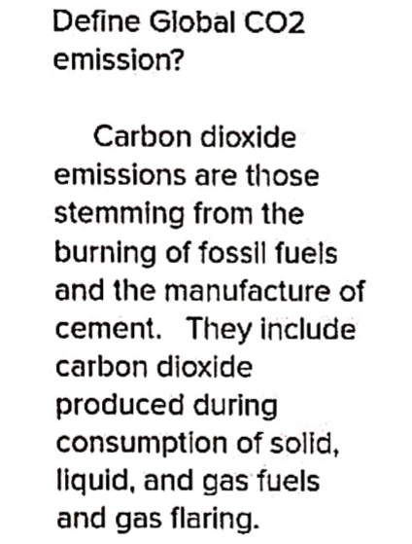
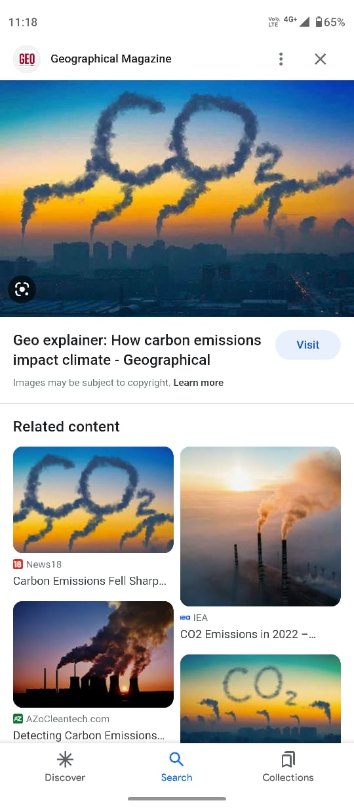
BRAINSTORMING STEP 1

Slide 8
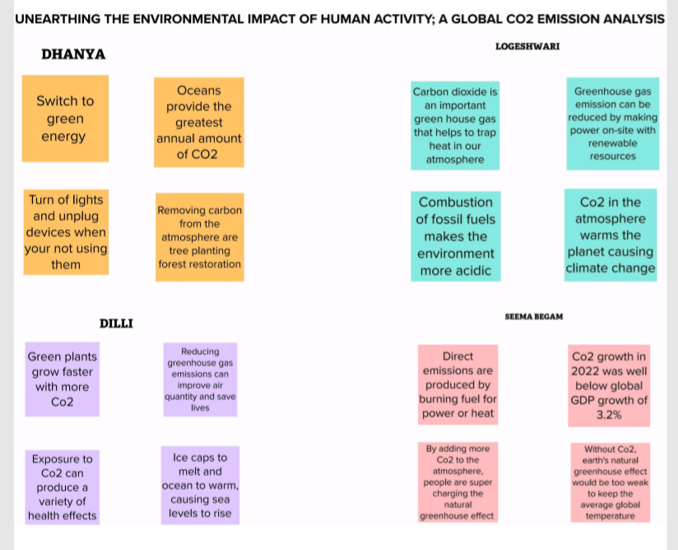
BRAINSTORMING STEP 2

Slide 9
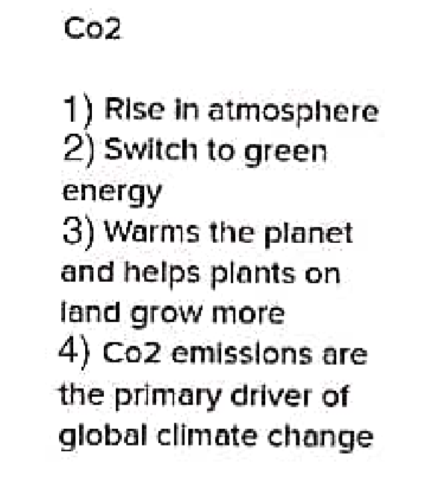
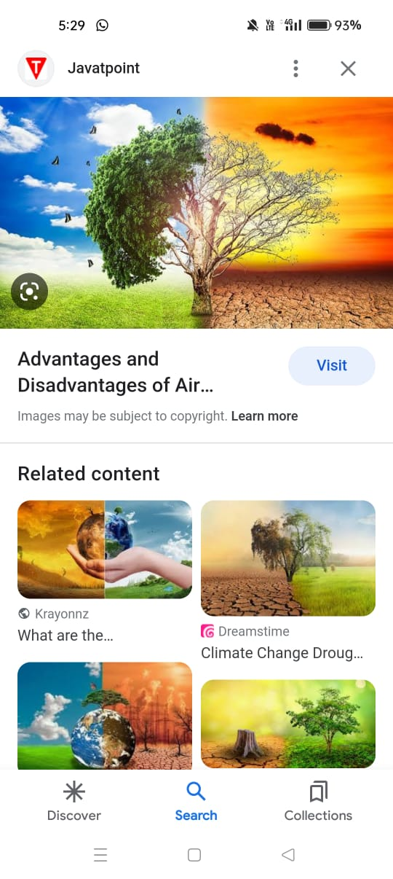
BRAINSTORMING STEP 3

Slide 10

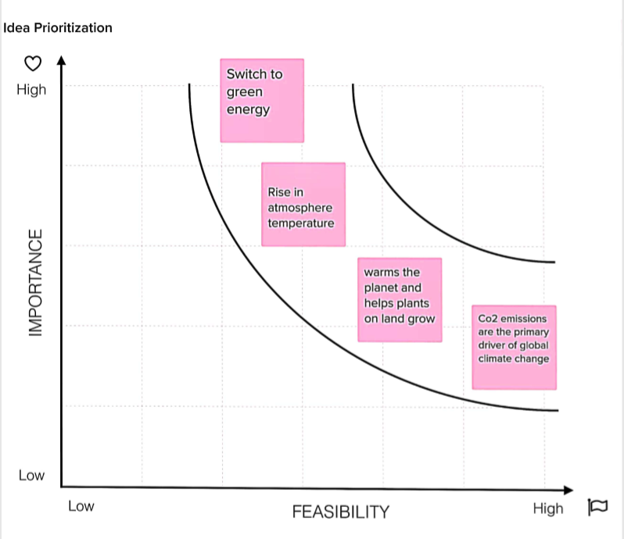
BRAINSTORMING STEP 4

Slide 11
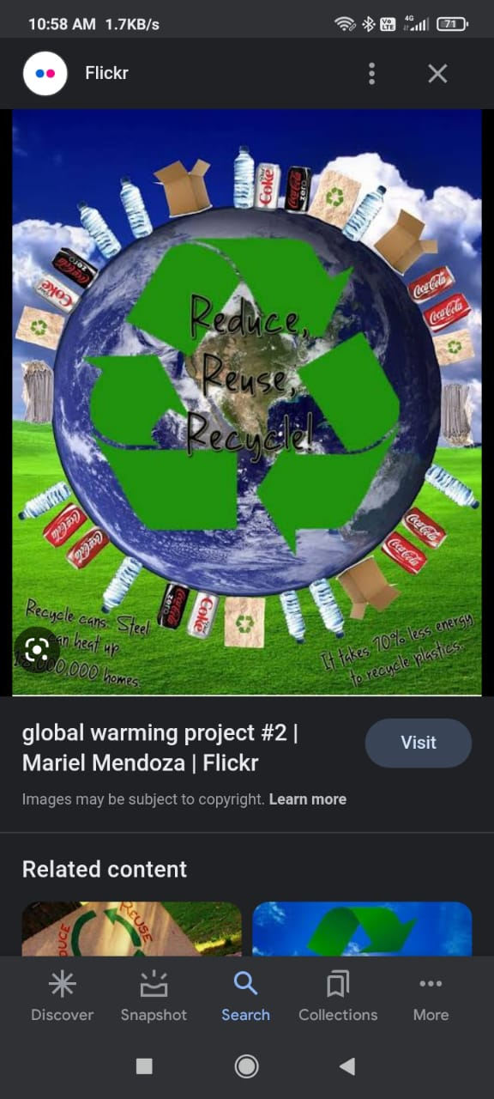
OUTPUT
The final output of co2 has various impacts on the environment and human health.
Some of the major natural sources that emit co2 include volcanic eruptions, wildfires and respiration by living organisms .
Human activities like burning of fossil fuels, deforestation are the major contributors to increase in atmospheric co2 levels.

Slide 12
ADVANTAGES AND DISADVANTAGES OF CO2
ADVANTAGES
DISADVANTAGES
Co2 is an important component of the Earth’s atmosphere.
It helps to regulate the temperature by trapping heat from the sun.
Co2 is natural by product of human respiration.
Co2 is a greenhouse gas, and lead to global waring and climate changes.
High levels of co2 can be toxic to humans and animals.
Co2 emissions from fossil fuel burning are major contributor to air pollution.

Slide 13
CO2 SOLUTIONS CAN BE APPLIED IN VARIOUS AREAS
Carbon capture and storage (CCS).
Carbon utilization.
Agriculture and forestry.
Renewable energy.
Food and beverage production.

Slide 14
CONCLUSION
In conclusion, the negative effect of co2 emissions, there are various efforts underway to reduce emissions and develop cleaner energy sources.
Governments, business, and individuals have a responsibility to take meaning action to reduce their carbon footprint and mitigate the impacts of climate change.
Together, we can work towards a more sustainable future and a healthier planet for generations to come.

Slide 15

FUTURE SCOPE
The future scope of co2 is primarily linked to its potential use has a feedstock for the production of various chemicals and materials.
Carbon dioxide can be converted into useful chemicals and materials using various technologies, such as chemical looping, electrochemical reduction, and biological conversions.
Carbon capture and storage (CCS) technology also has a significant potential for reducing greenhouse gas emissions for industrial processes and power generation.
Co2 has both challenges and opportunities for the future. Recognizing the potential of co2 has a resource, government and industries must work together to develop and deploy the necessary technologies to convert co2 into valuable products while minimising its impact on the environment.

